Slide 1

Design pattern
Lecture 5

Slide 2
Design Pattern
What is design pattern?
Christopher Alexander says,“Each pattern describes a problem which occurs over and over again in our environment, and then describe the core of the solution to that problem, in such a way that you can use the solution a million times over, without ever doing it the same way twice”.
Even though Alexander was talking about patterns in buildings and towns, what he says is true about object-oriented design patterns.

Slide 3
Design Pattern
What is design pattern?
In general, a pattern has four essential elements:
The pattern name is s handle we can use to describe a design problem, its solutions, and consequences in a word or two.
The problem describes when to apply the pattern. It explains the problems and its context.
The solution describes the elements that make up the design, their relationships, responsibilities, and collaborations.
The consequences are the results and trade-off of applying the pattern.

Slide 4
Design Pattern
Purpose | Design pattern
Creational | Abstract Factory
 | Builder
 | Factory Method
 | Prototype
 | Singleton
Structure | Adapter
 | Bridge
 | Composite
 | Decorator
 | Façade
 | Flyweigh
 | Proxy

Slide 5
Design Pattern
Purpose | Design pattern
Behavioral | Chain of Responsibility
 | Command
 | Interpreter
 | Iterator
 | Mediator
 | Memento
 | Observer
 | State
 | Strategy
 | Template Method
 | Visitor

Slide 6
Creational pattern

Slide 7
Creational Pattern—Introduction
The creation of an object
Villa object
Swimming pool
Garden
Billing
Apartment object
Room
Balcony

Slide 8
Creational Pattern—Introduction
The creation of an object
if ( info.type == “House” ) House ob = new House();
ob.setPool (info.poolsize);
ob.setGardon (info.gardonsize);
ob.setStyle (info.style);
if ( info.type == “Cando” ) Cando ob = new Cando();
ob.setRoom (info.poolsize);
ob.setBalcony (info.gardonsize);
ob.setStyle (info.style);
ob.count ();

Slide 9
Creational Pattern—Overview
Motivation
In object-oriented programming, when writing code that creates objects, you often need to set up many conditional statements to determine under what conditions, when, and how to create objects of a certain class. Therefore, it is necessary to delegate the responsibility of creating an object to a particular class.
Aims
The purpose is to increase flexibility in which objects are created, who is responsible for creating the object, how to create the object, and when to create the object.
Content
The Creational software design pattern is a design pattern that addresses the object creation mechanism.

Slide 10
Creational pattern
Factory and Abstract Factory

Slide 11
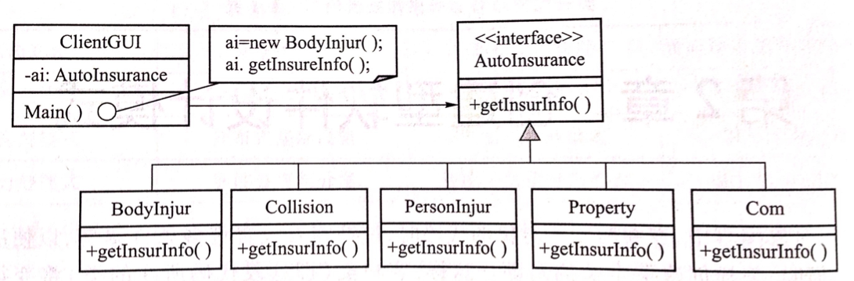
Introduction
Suppose you want to design a car insurance management program. Car insurance is divided into many types of insurance, such as Body Injur, Collision, Personal Injur, Property, and Com. If an application knows exactly what it needs, it can directly initialize a subclass of the class structure from the client class's main method and call the functionality provided by that class. For example, when it is known exactly that the class to be initialized is Body Injur, the case is invoked by the auto insurance management program as shown in Figure 1.
Figure1 Knowing exactly the class to initialize is BodyInjure

Slide 12
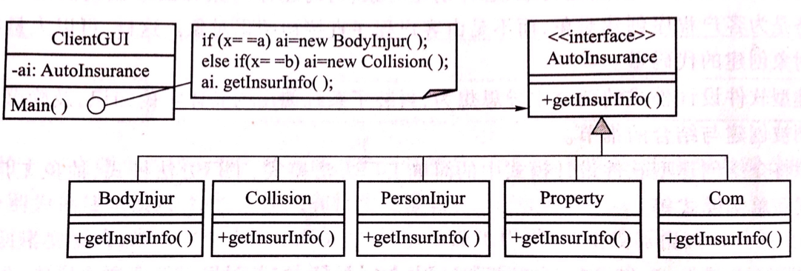
Introduction
Usually an application only knows that it needs to access a class in a class hierarchy, but does not know which class it needs to access. In this case, the application needs to implement the selection criteria for selecting the appropriate class from a class hierarchy, as shown in Figure 2.
Figure2 Do not know which class to initialize

Slide 13
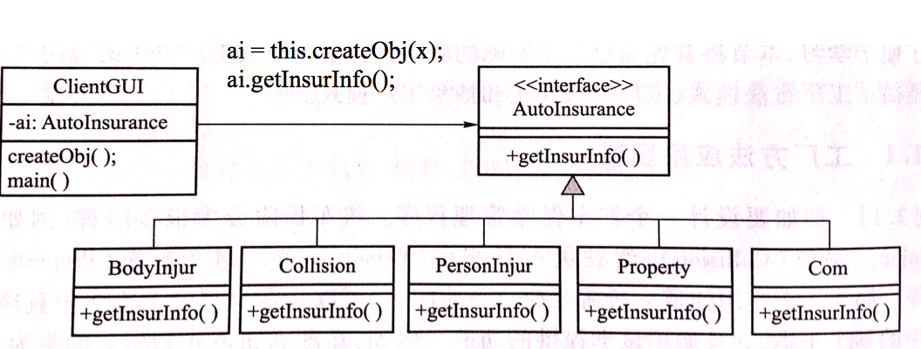
Introduction
In the main method main() shown in FIG. 2, directly selecting which of the first class methods using a conditional statement will make the program messy and reduce the readability of the program. An effective improvement is to write a separate method createObj() in the ClientGUI class to create an object. This method encapsulates all the different conditions for creating an object, as shown in Figure 3. However, this method has poor scalability and maintainability.
Figure3 Responsibility for creating a class object is encapsulated in a separate method

Slide 14
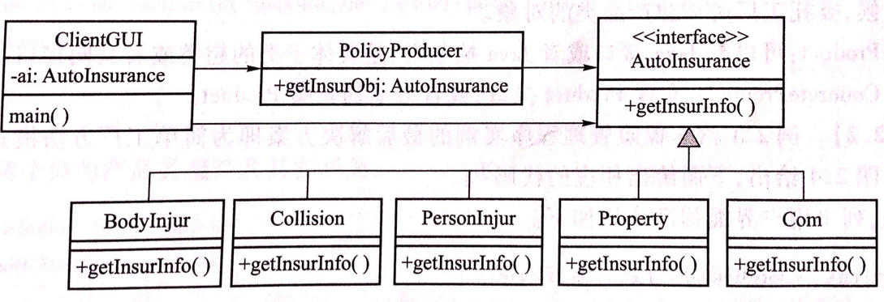
Introduction
After long-term practice, software engineers have found a more scalable method. This method is to separate the above method of creating an object from the ClientGUI class, and create the object by another class. The design encapsulates the choice of the class and the creation of the object in a method (ie, a factory method) and encapsulates the method in a separate class (ie, a factory class). As shown in Figure 4, the PolicyProducer class is a factory class, where getInsurObj is a factory method.
Figure4 Responsibility for creating a class object is encapsulated in a separate class

Slide 15
Introduction
The advantages of the factory method:
Using factory methods to access and initialize objects of the appropriate class simplifies the application. The application itself no longer contains a large number of conditional statements to determine which class to select.
The factory method implements some special initial class mechanism, especially when the different hierarchical classes require different initialization methods.
The factory method returns an object of the parent class, and the client program does not need to know the existence of this initialized class.
Factory method design patterns can be divided into simple factory method patterns, factory method patterns, and abstract factory patterns.

Slide 16
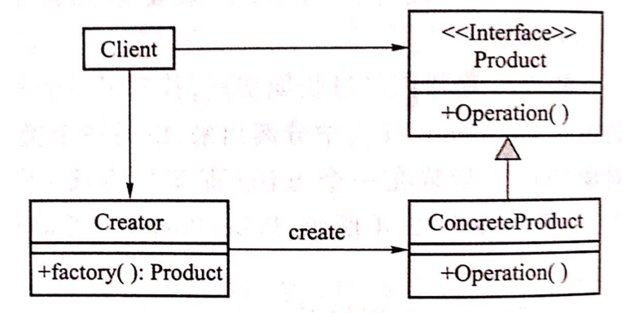
Simple Factory
Figure5 Simple factory class diagram
The design class diagram for the simple factory method pattern is shown in Figure 5. The Creator class in the figure is a factory class. The class in the right half of the figure is called the product class and consists of the interface Product and concrete product class ConcreteProduct.

Slide 17
Simple Factory
Figure5 Simple factory class diagram
Creator cr = new Creator();
Product p = cr.factory(“option”); p.Operation();

Slide 18
Simple Factory
Advantage
The factory class includes business logic that selects the initial class from the structure of a class and achieves separation of responsibilities.
The client class does not have responsibility for creating objects of the class. There are no conditional statements required to create the object. Therefore, if a new product subclass is added, the existing client class code does not have to be modified.
Disadvantages
The factory class must know how to create an object for each subclass, and whenever the product class is added, the factory class code needs to be modified.

Slide 19
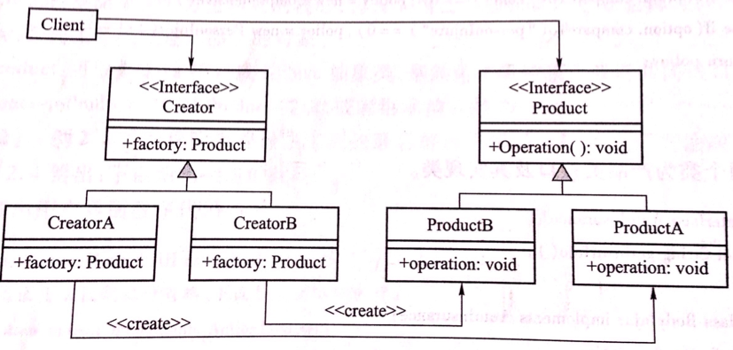
Factory
Figure6 Factory class diagram
In order to overcome the shortcomings of the simple factory method model, people try to improve the structure of the factory class. Software designers have found that it is possible to solve this problem by rewriting a single factory class in a simple factory method schema to a hierarchical class. First you need an interface as a superclass called creator. There is a method in the interface called factory(); then you can use the same structure as the product class to create the creator class structure, which contains creatorA and creatorB, each responsible for creating the corresponding ProductA And ProductB objects, as shown in Figure 6. In Figure 6, each product class corresponds to a factory class. The factory class is only responsible for creating the corresponding product class object.

Slide 20
Factory
Figure6 Factory class diagram
Creator cr = null; if ( x = a ) cr = new CreatorA();
else
cr = new CreatorB();
Product p = cr.factory();

Slide 21
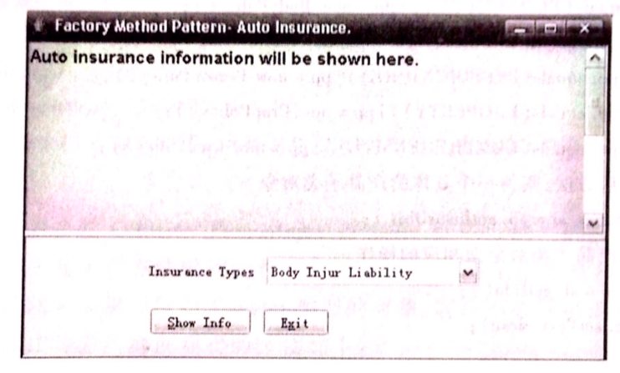
Factory Example
Figure7 User interface of car insurance management program designed using factory method pattern
Use the factory method model to design the car insurance management application of Example 1. The application have a user graphical interface, as shown in Figure 7. On the user graphical interface shown in Figure 7, the user can select different types of insurance and then click on the “Show Info” button. The description of this type of insurance will then be displayed in the upper part of the graphical interface.

Slide 22
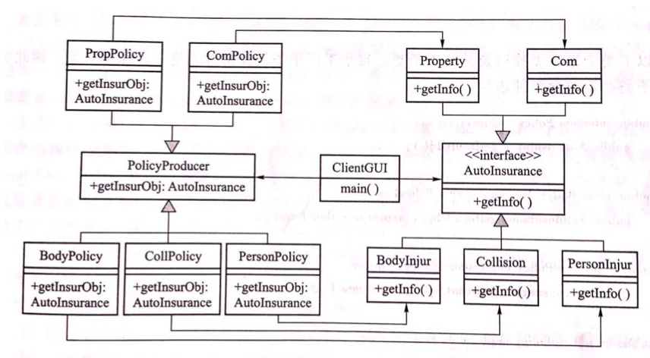
Factory Example
Figure8 Car insurance management application designed using factory method mode
According to the factory method pattern, the following design class diagram is obtained. The difference from the simple factory method pattern is that in the simple factory method pattern, the PolicyProducer is a separate class, and the PolicyProducer class of the factory method pattern is not a separate class but a hierarchical class. The design class diagram is shown in Figure 8.

Slide 23
Factory Example
Figure8 Car insurance management application designed using factory method mode
PolicyProducer pp = null; if ( x = “BodyPolicy” ) pp = new BodyPolicy(); else if ( x = “Collision” ) pp = new CollPolicy(); else if ( x = “PersonInjure” ) pp = new PersonPolicy();
else if ( x = “Property” ) pp = new PropPolicy(); else if ( x = “Comprehensive” ) pp = new ComPolicy(); AutoInsurance ai = pp.getInsurObj();

Slide 24
Factory
The difference between the simple factory mode and the factory method pattern
The two models have different centers.
Whether to support the Open Closed Principle
Create the position of the object logic judgment.
Application scenario of factory method pattern
The logic of creating objects of certain classes is more complex and may also add new conditions
Need to encapsulate the logic of creating class objects, making these logical localizations

Slide 25
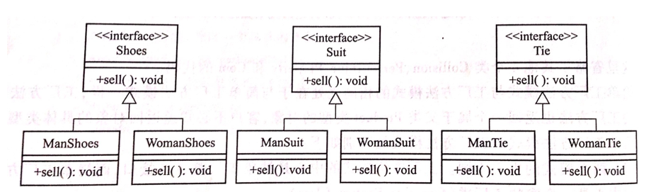
Abstract Factory—Introduction
Figure 9 Three products with the same form
If there are more than two sets of product classes with the same structure, can you also use the factory method model? For example, there are three sets of products, Shoes, Suit, and Tie, as shown in Figure 9. Products are divided into male and female categories. Question: Is it possible to use the above factory method mode at this time? If the answer is yes, how to apply the factory method mode?
Solution 1: Create a Creator hierarchy class for each product hierarchy class. One drawback of this approach is that it requires at least 3 Creator level classes. This approach is feasible but too cumbersome.

Slide 26
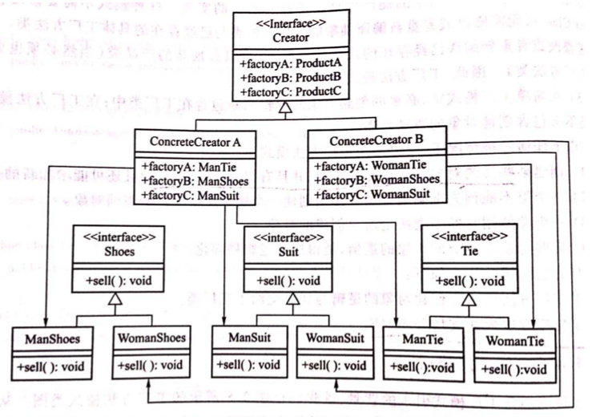
Abstract Factory—Introduction
Figure 10 Responsibility for creating three sets of product objects with one factory category
Solution 2: The above three hierarchical classes have the same structure, and the above-mentioned factory method pattern can be modified so that only one plant level class can take responsibility for creating three sets of product objects. The design is shown in Figure 2.10.

Slide 27
Abstract Factory—Introduction
Figure 10 Responsibility for creating three sets of product objects with one factory category
Creator cr = null; if ( x ==a ) cr = new ConcreteCreatorA(); else if ( x == b ) cr = new ConcreteCreatorB(); if ( y = “ManTie” ) ManTie mt = cr.factoryA(); else if ( y = “WomanTie” ) WomanTie wt = cr.factoryA(); else if ( y = “ManShoes” ) ManShoes ms = cr.factoryB(); else if ( y = “WomanShoes” ) WomanShoes ws = cr.factoryB();
else if ( y = “ManSuit” ) ManSuit msi = cr.factoryC(); else if ( y = “WomanSuit” ) WomanSuit wsi = cr.factoryC():

Slide 28
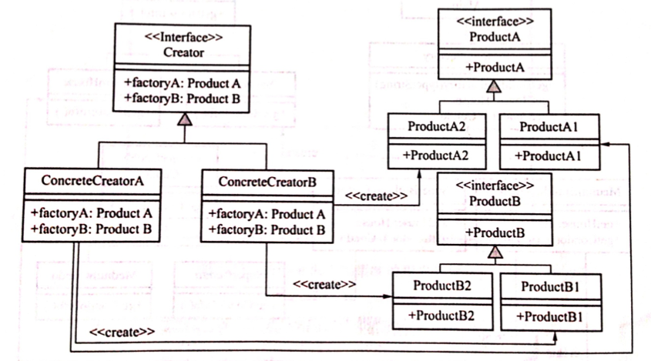
Abstract Factory—Introduction
Figure 11 Abstract factory pattern design class diagram - two product categories
The Abstract Factory Pattern contains two product class abstract factory pattern design class diagram as shown in Figure 11.

Slide 29
Abstract Factory—Introduction
Figure 11 Abstract factory pattern design class diagram - two product categories
Creator cr = null;
if ( x == 1 ) cr = new ConcreteCreatorA();
else if ( x == 2 ) cr = new ConcreteCreatorB();
if ( y == A ) Product a = cr.factoryA();
else Product b = cr.factoryB();

Slide 30
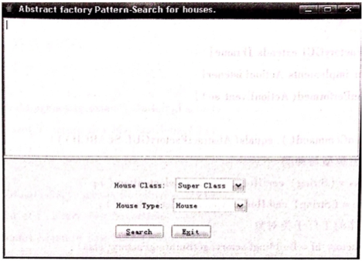
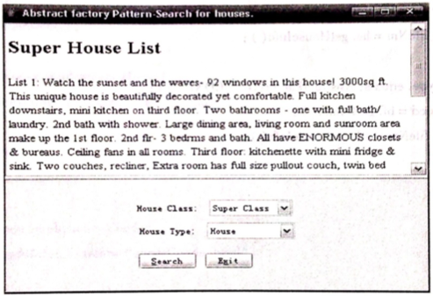
Abstract Factory—Example
Design a home sales inquiry system to query the introduction, prices and addresses of different types of houses. For the sake of simplicity, only two types of houses are considered: the House and the Condo. And suppose that each type of house contains: Super and Medium.
Since House and Condo are classified into two categories, Super and Medium, and the villa structure and the apartment structure have the same structure, you can consider using the abstract factory pattern to design the house search system.
Figure 12
Figure 13

Slide 31
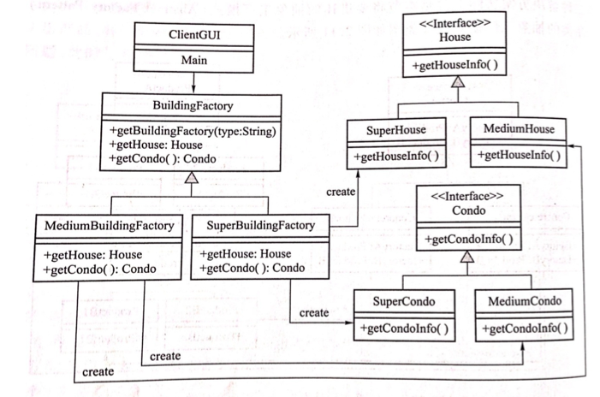
Abstract Factory—Example
Figure 14
BuildingFactory bf = BuildingFactory.getBuildingFactory(“option”);
if ( x == “House” ) House hs = bf.getHouse();
else if ( x == “Cando” ) Cando cd = bf.getCando();

Slide 32
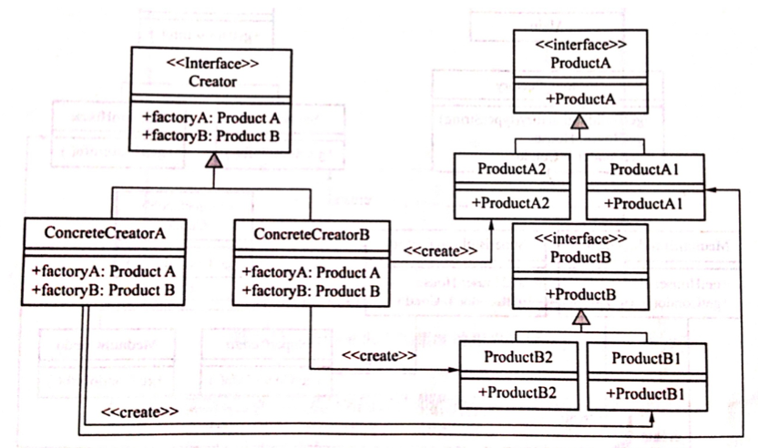
Abstract Factory—Example
The scalability of Abstract factory pattern
Figure 15 Abstract Factory Pattern Design Class Diagram - Two Product Classes

Slide 33
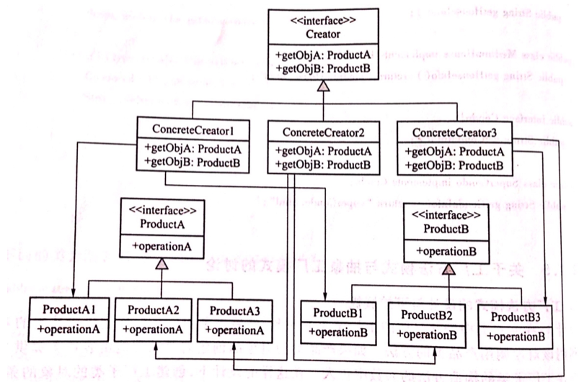
Abstract Factory—Example
Figure 16 Abstract Factory Pattern Design Class Diagram –conform to Open and Close Principles
If you need to increase ProductA3 and ProductB3, the factory class class needs to increase the class ConcreteCreator3. In this case, the abstract factory pattern conform to the opening and closing principle.

Slide 34
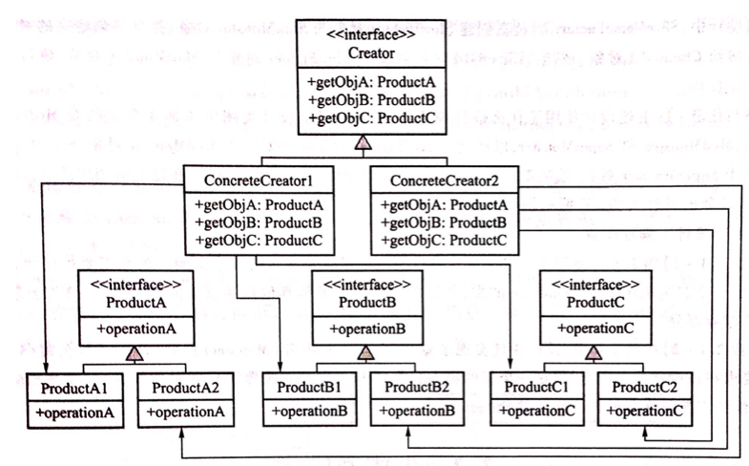
Abstract Factory—Example
Figure 17 Abstract Factory Pattern Design Class Diagram –does not conform to Open and Close Principles
If you want to add a new product hierarchy class, ProductC, you must add a method to each factory real class. +getObjC In this case, the abstract factory pattern does not conform to the opening and closing principle.

